Slide 1
Map of Tasks
Algorithms and Data structures

Slide 2
Introduction
Optimizing task completion strategy for IIOT contest
The Industrial Internet of Things (IIOT) represents a convergence of industry with the power of connected technology.
In preparation for the competition, students face a complex task scheduling challenge.
Each task, varying in complexity and time requirements, is a stepping stone towards building a competitive IIOT solution.

Slide 3
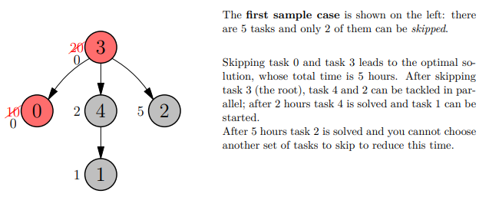
Problem description
Understanding the challenge
Objective: calculate the minimum hours to solve all tasks.
Constraints: task dependencies and a limited number of 'cheats'.
Example:

Slide 4
Algorithm overview
Dynamic approach
Structure: tasks are nodes in a rooted tree; parent-child relationships indicate task dependencies.
Traversal: recursion is used to traverse this tree and calculate the cost of each subtree.
Cheating strategy: at each node, we decide whether to 'cheat' on the task based on its impact on the overall completion time.

Slide 5
Dynamic programming in detail
Deep dive into Dynamic Programming
Memoization technique: cache the minimum time required to complete each subtree with a certain number of cheats.
Recursive 'cheat' function: calculates the minimum time for each node, considering whether to cheat on the task or complete it normally.
Optimal substructure: the solution for each node is based on the solutions of its children, a hallmark of dynamic programming.

Slide 6
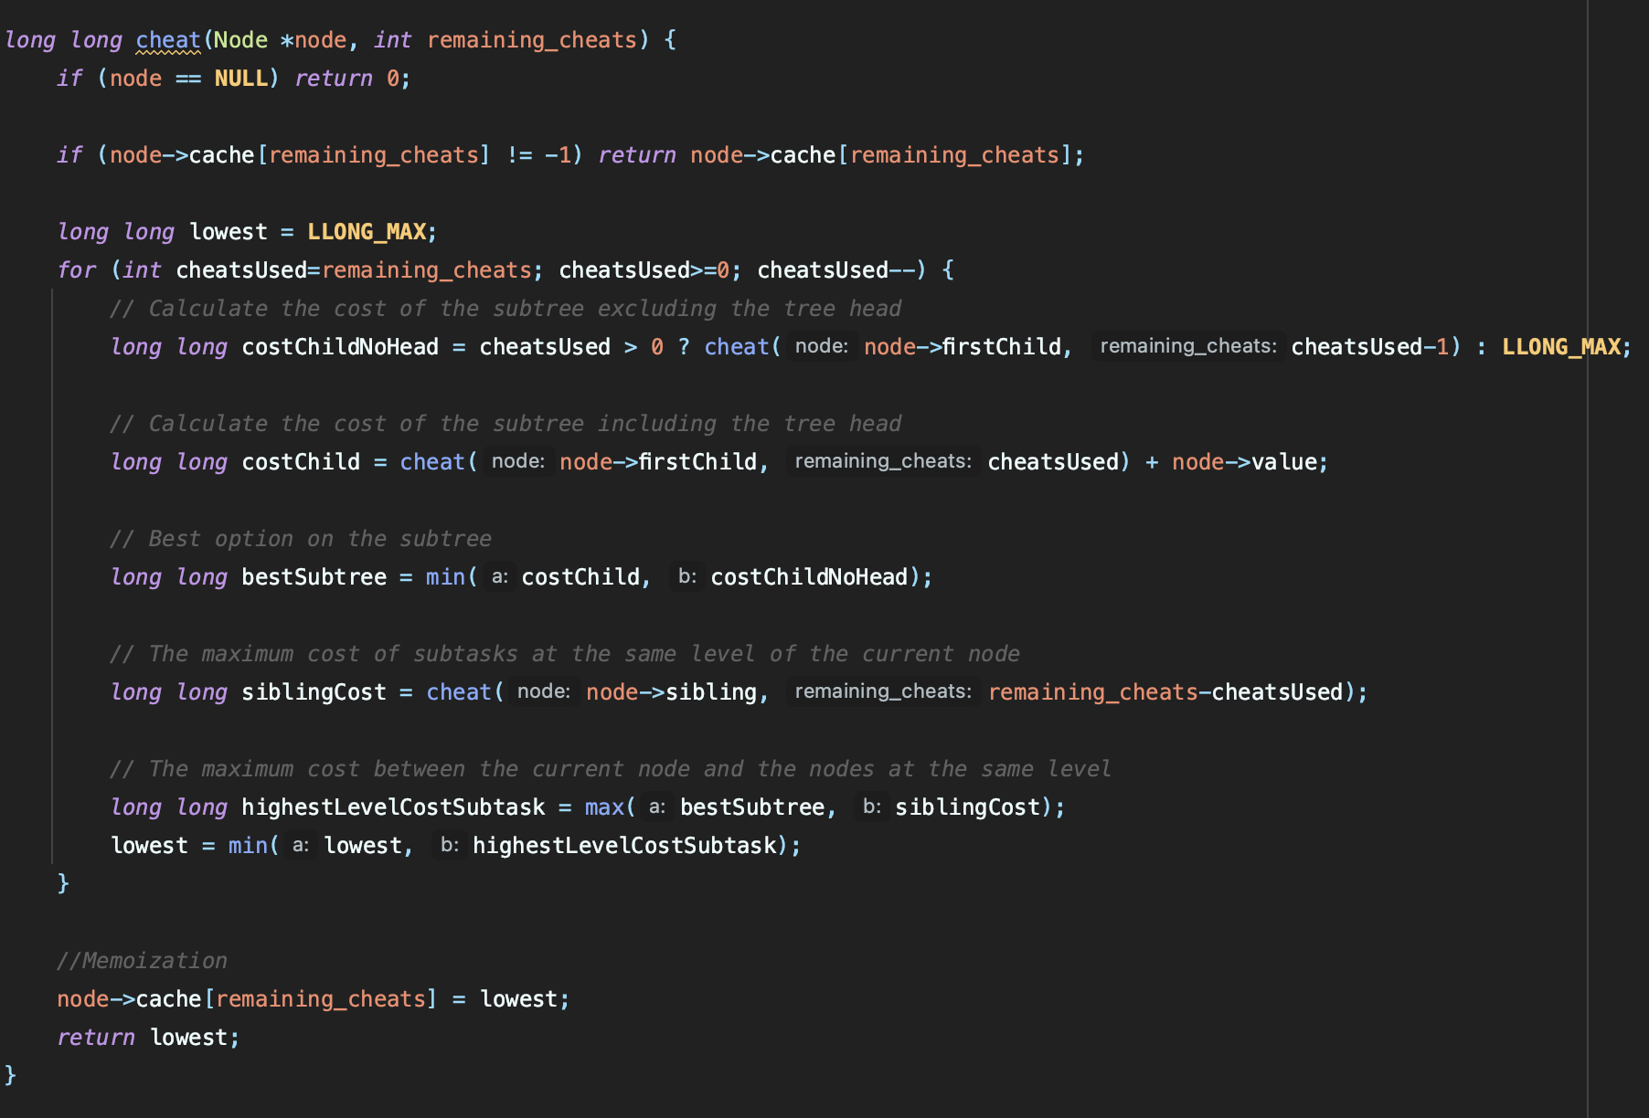
Cheating strategy: implementation

Slide 7
Computational complexity
Computational complexity calculation
Key Factors: Depends on the number of nodes (N) and the number of cheats (C).
Tree Construction: O(N) - Each node is processed once to build the tree.
Dynamic Programming (cheat Function): O(N * C) - Each node is evaluated with each possible number of remaining cheats. Memoization ensures each state is computed only once.
Overall Complexity: O(N * C) - Dominated by the dynamic programming part, as it's the more complex operation.

Slide 8
Limitations and alternatives
Exploring limitations and alternatives
Limitations: the algorithm may face scalability issues with very large trees or a high number of cheats due to its polynomial complexity.
Alternative methods: greedy algorithms could offer faster computations but may not always yield the optimal solution. Brute force approaches are impractical for large N and C due to exponential time complexity.

Slide 9
Conclusions
Conclusions and future directions
Achievements: successful implementation of a dynamic programming approach to efficiently solve a complex problem.
Insights: gained a deeper understanding of optimizing algorithms and managing computational resources effectively.
Future work: potential improvements include exploring different data structures for efficiency gains or extending the algorithm to handle more complex task dependencies and constraints.

